Slide 1
The Engineering Computational Laboratory
Charles Xie

Slide 2
Four Focus Areas of Research and Development at the Intersection of Engineering and Education
Renewable Energy
Energy Efficiency
Big Data
CAD
Computation
Sensors
Citizen Science
Artificial Intelligence
Internet of Things

Slide 3
The CAD Frontier
Powercraft (Energy3D)
Renewable Energy
Virtual Solar Grid
CAD
Generative Design
Artificial Intelligence
Intelligent Design Tutor

Slide 4
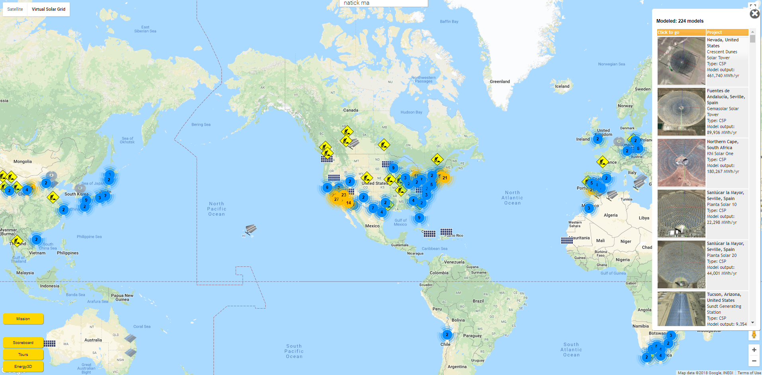
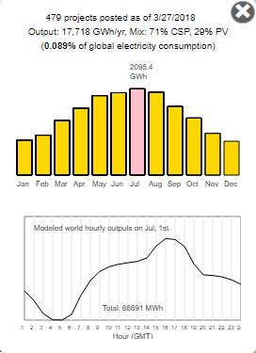
Solar Work (Powercraft + Virtual Solar Grid)
Powercraft (Energy3D)
A Minecraft-like CAD modeling and simulation tool that
turns engineering into design and construction games in
the context of renewable energy and on the canvas of
Google Maps.
Front end
Google Maps
A global network of solar energy systems that supports
international collaboration to investigate a big question:
Can humanity be realistically powered by 100% renewable
energy in 2050 (32 years from now)?
Back end
Virtual Solar Grid

Slide 5
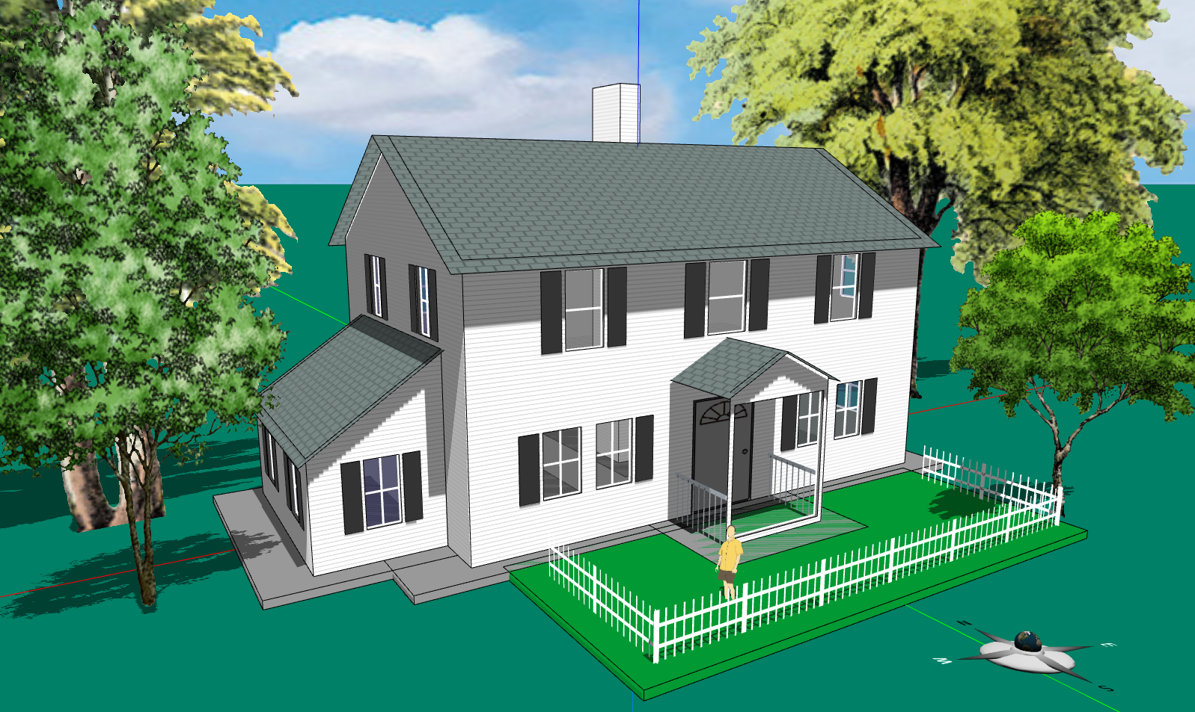
Examples: Architectural Design

Slide 6
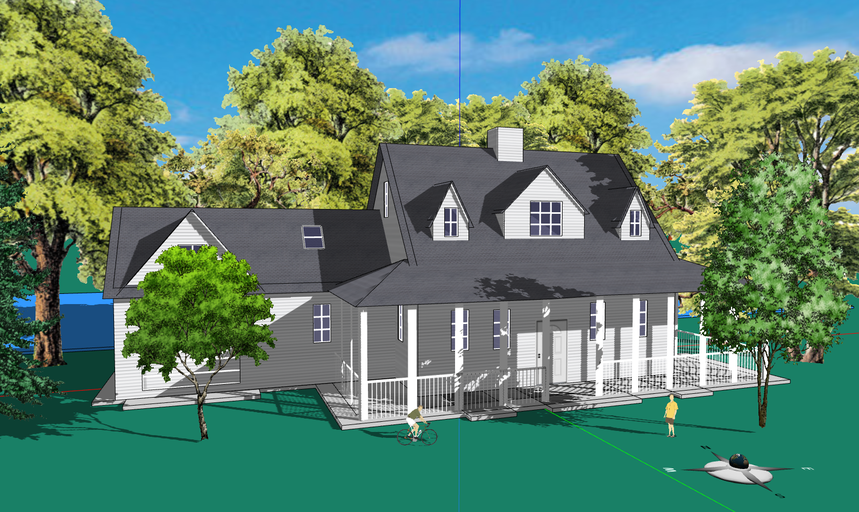
Examples: Architectural Design

Slide 7
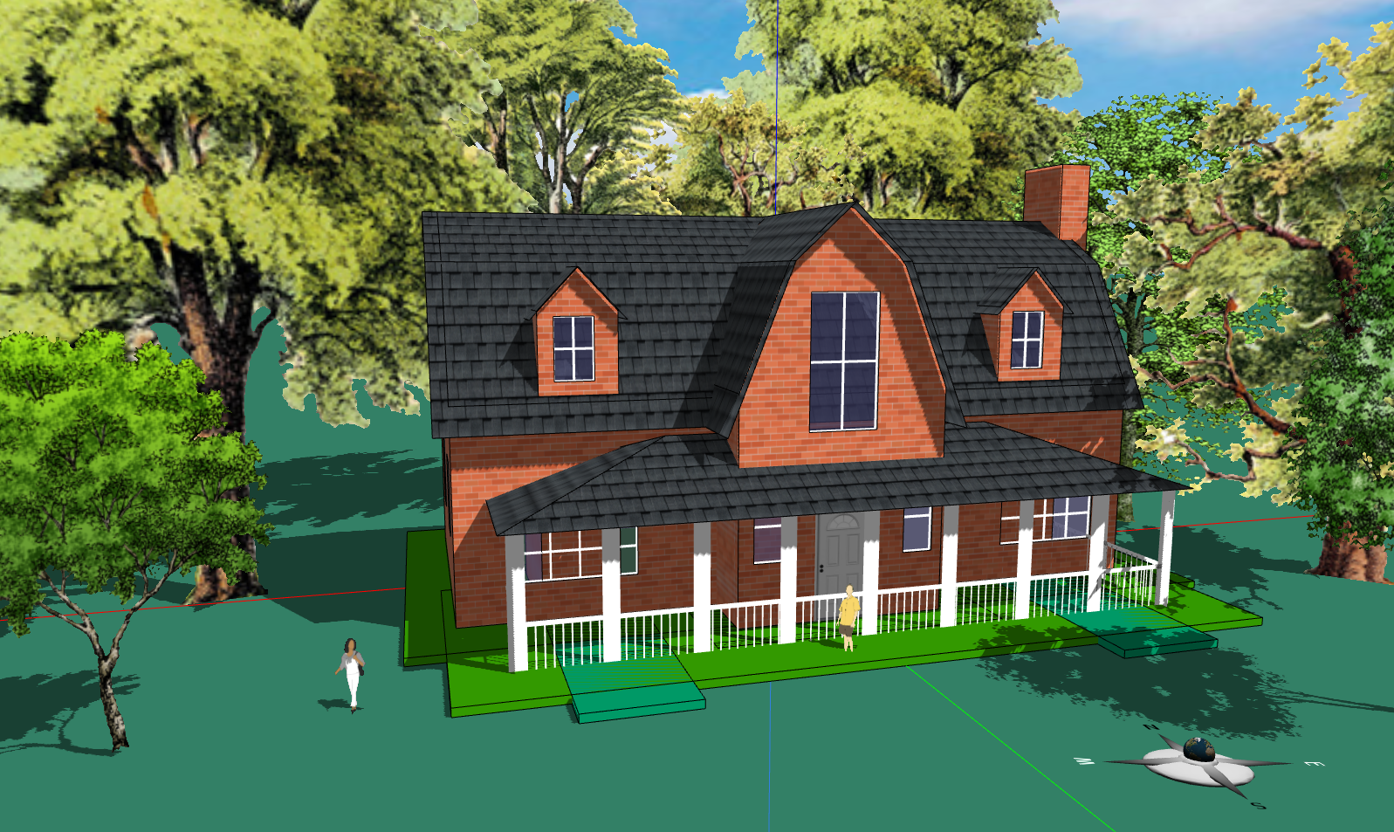
Examples: Architectural Design

Slide 8
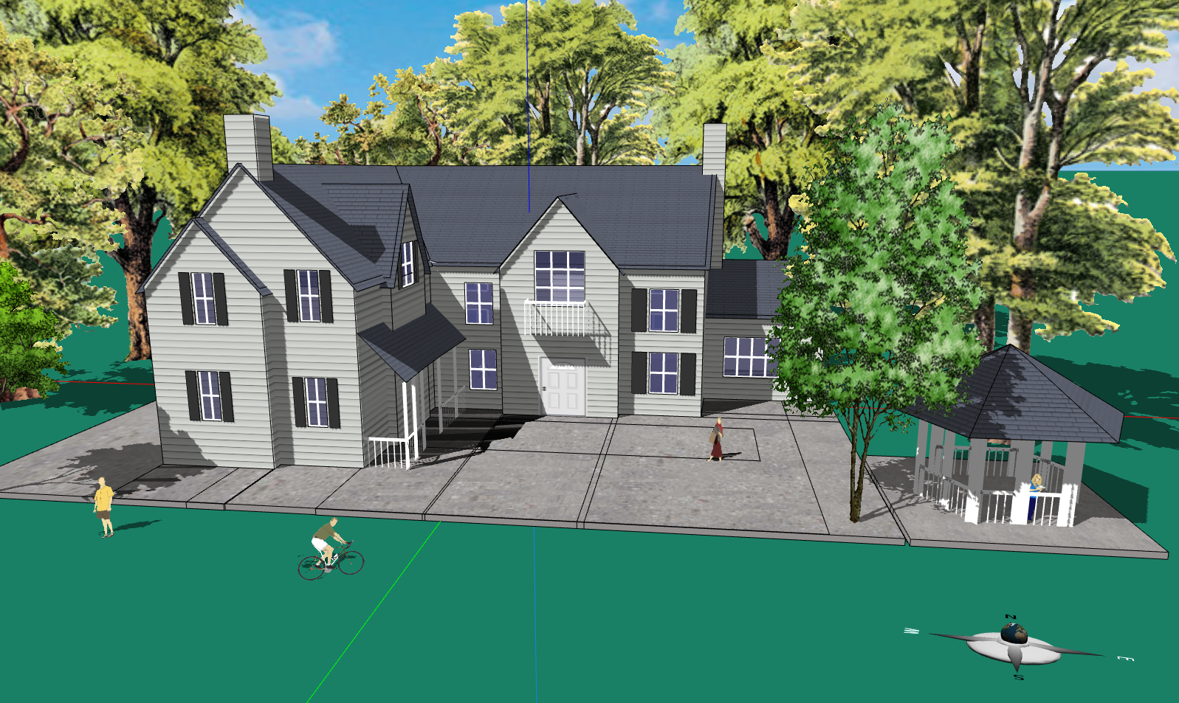
Examples: Architectural Design

Slide 9
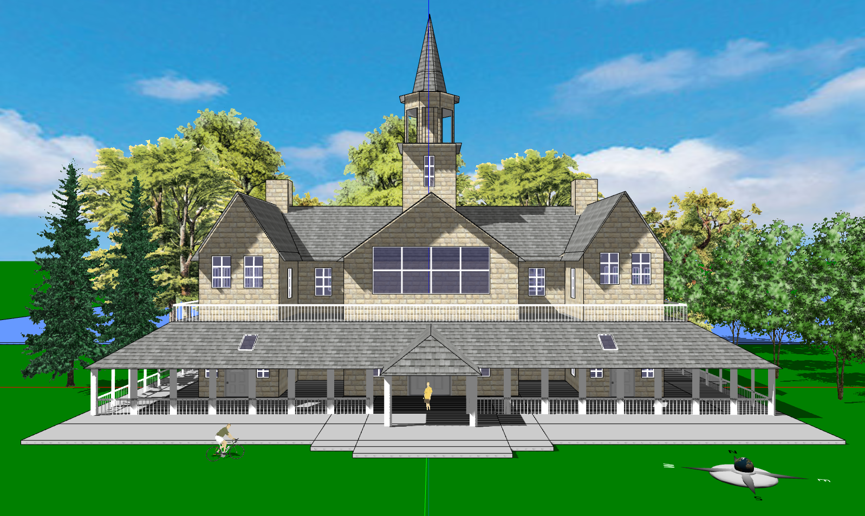
Examples: Architectural Design

Slide 10
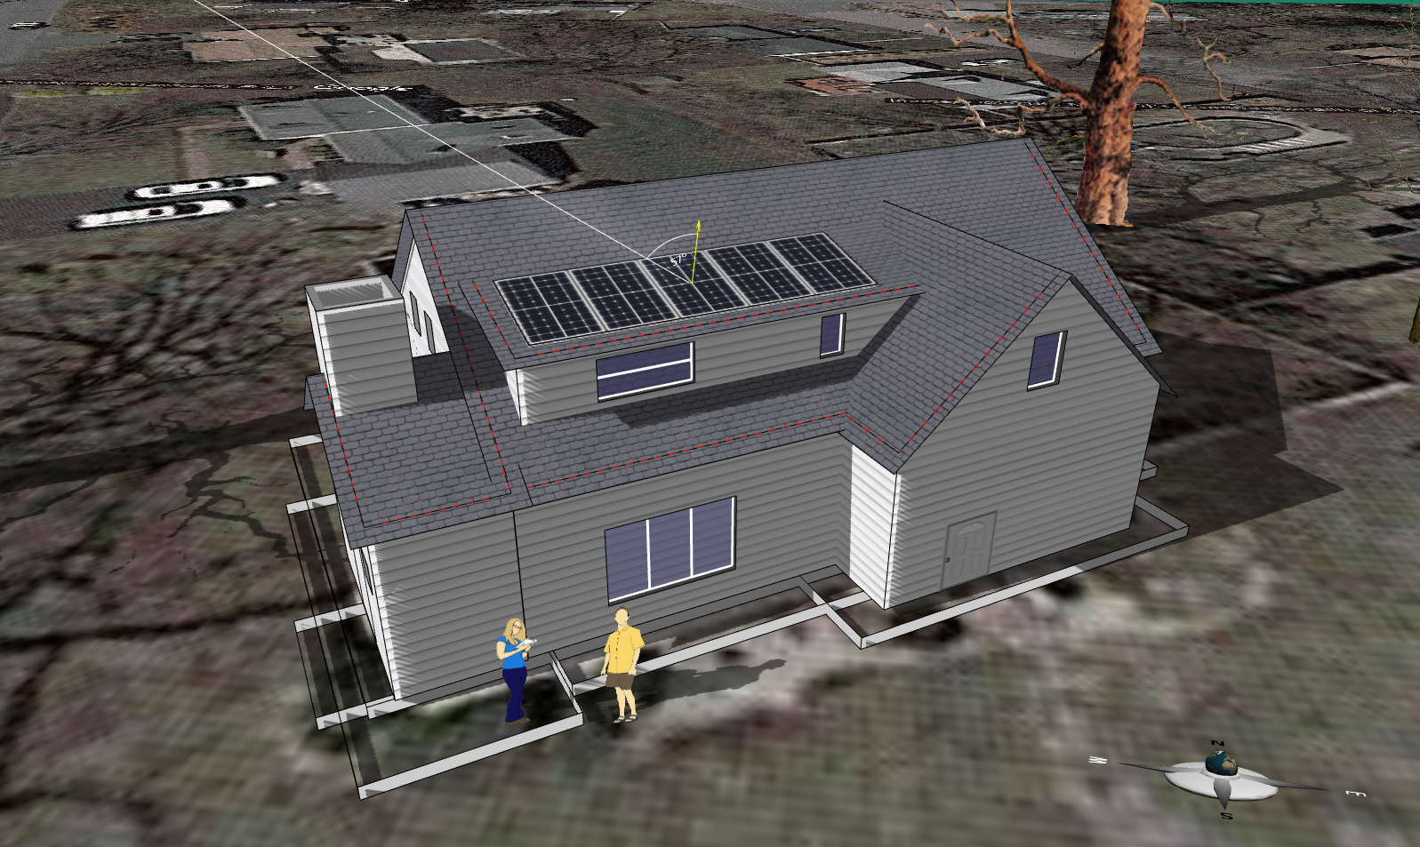
Examples: Solarize Your Home (Braintree, MA)

Slide 11
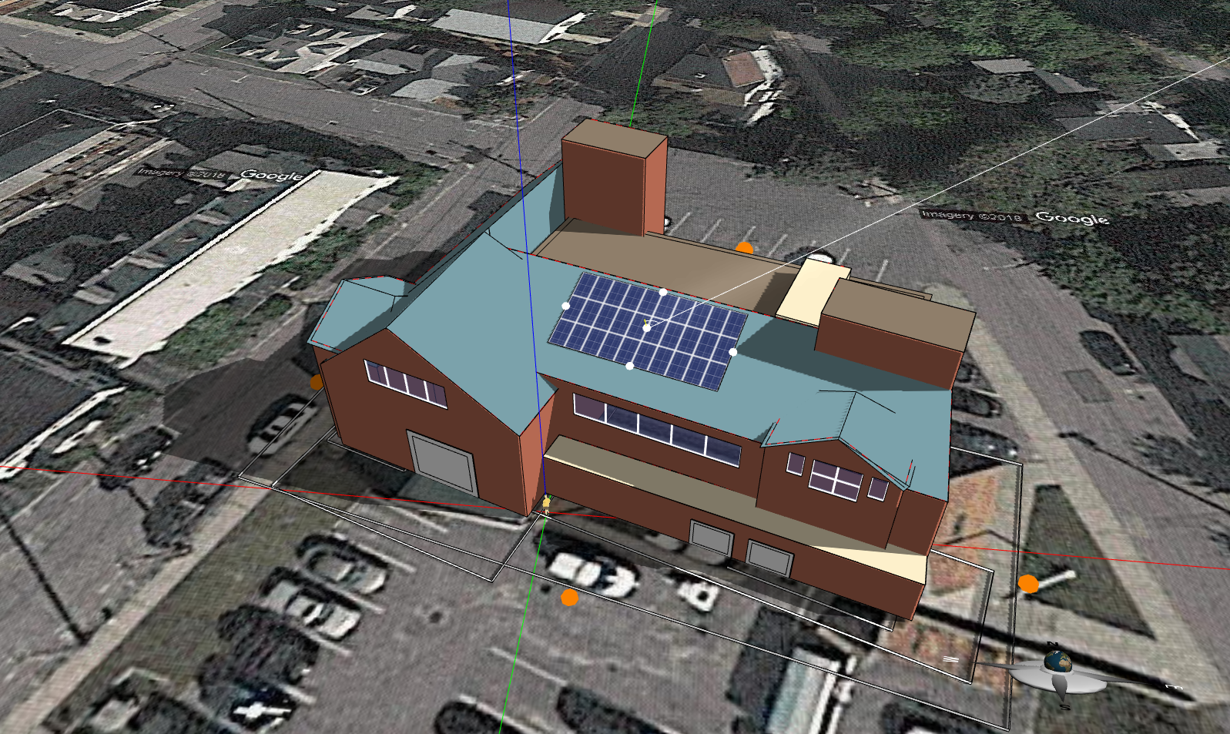
Examples: Solarize a Public Building (Fitchburg Police Department, MA)

Slide 12
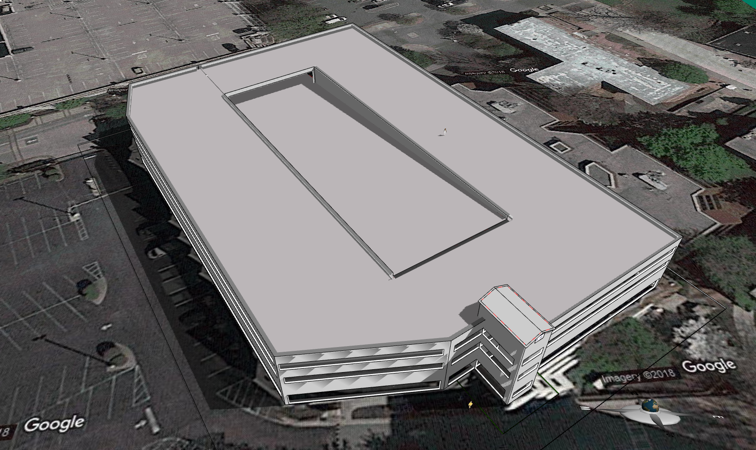
Examples: Solarize a Parking Garage (Spelman College, GA)

Slide 13
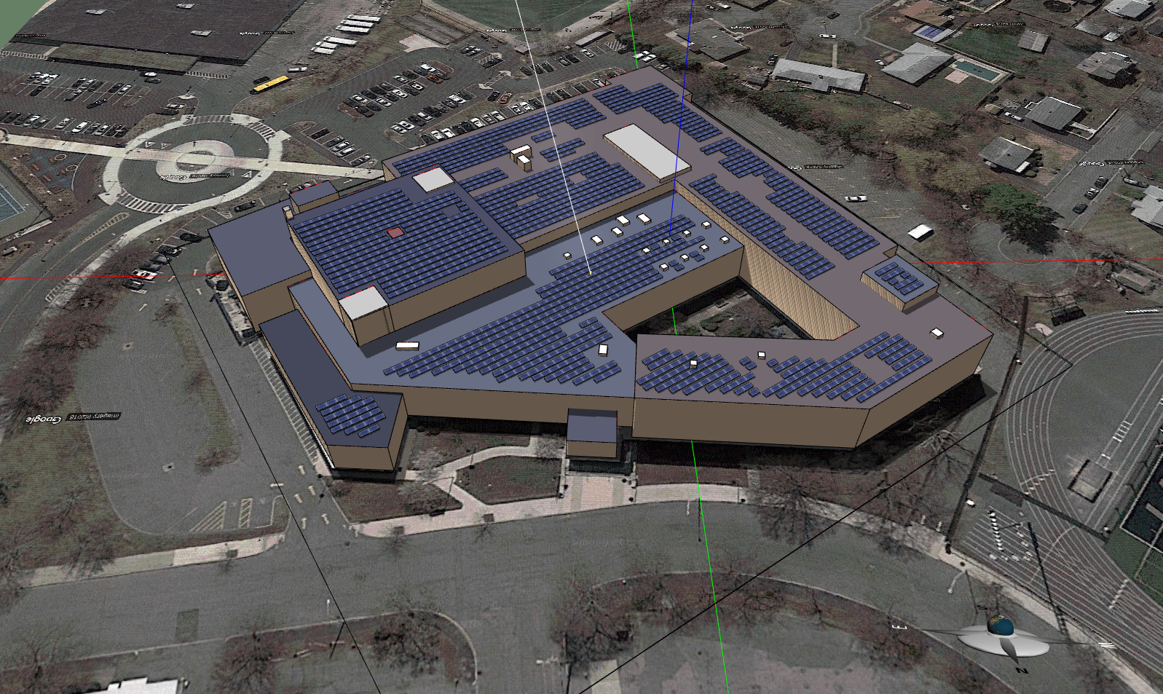
Examples: Solarize Your School (Malden Catholic High School, MA)

Slide 14
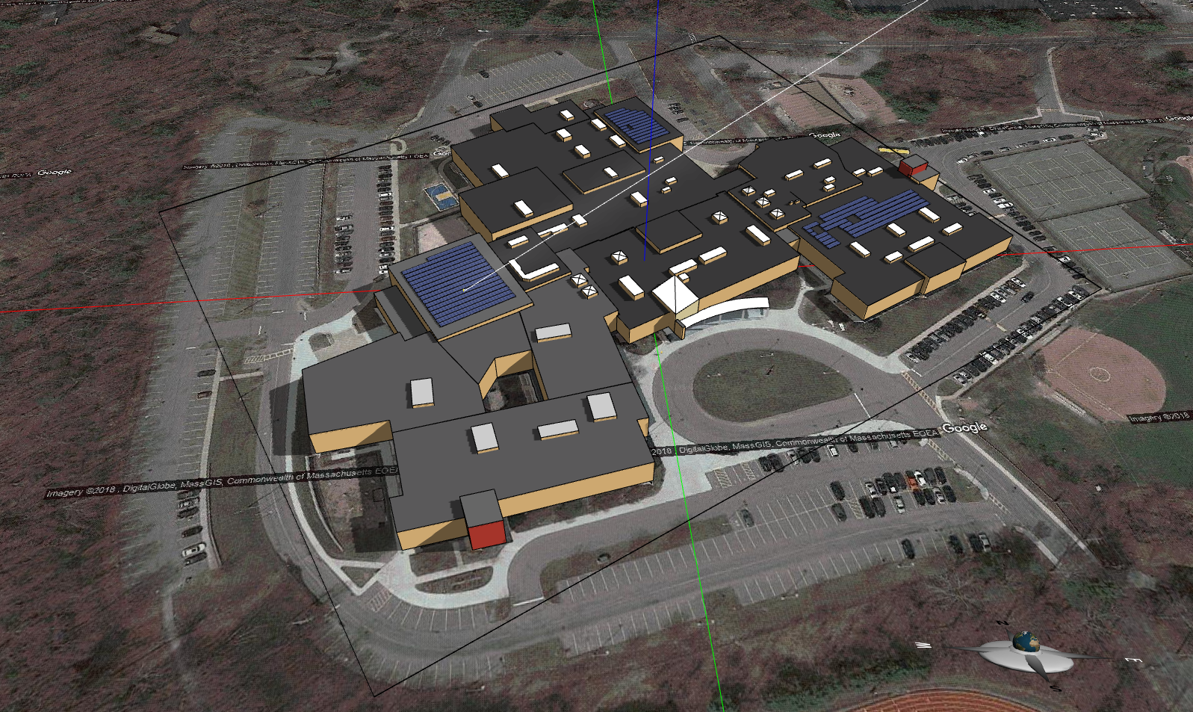
Examples: Solarize Your School (Acton-Boxborough High School, MA)

Slide 15
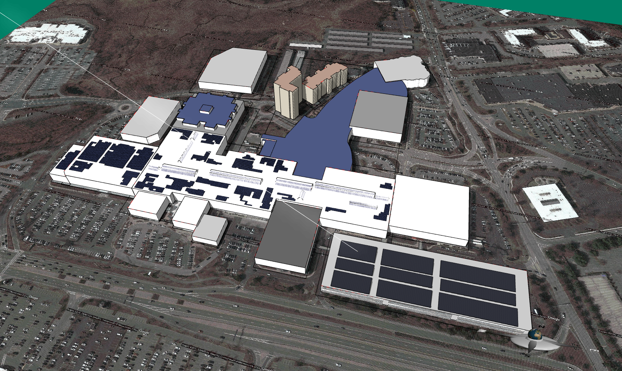
Examples: Solarize Your Stores (Natick Mall, MA)

Slide 16
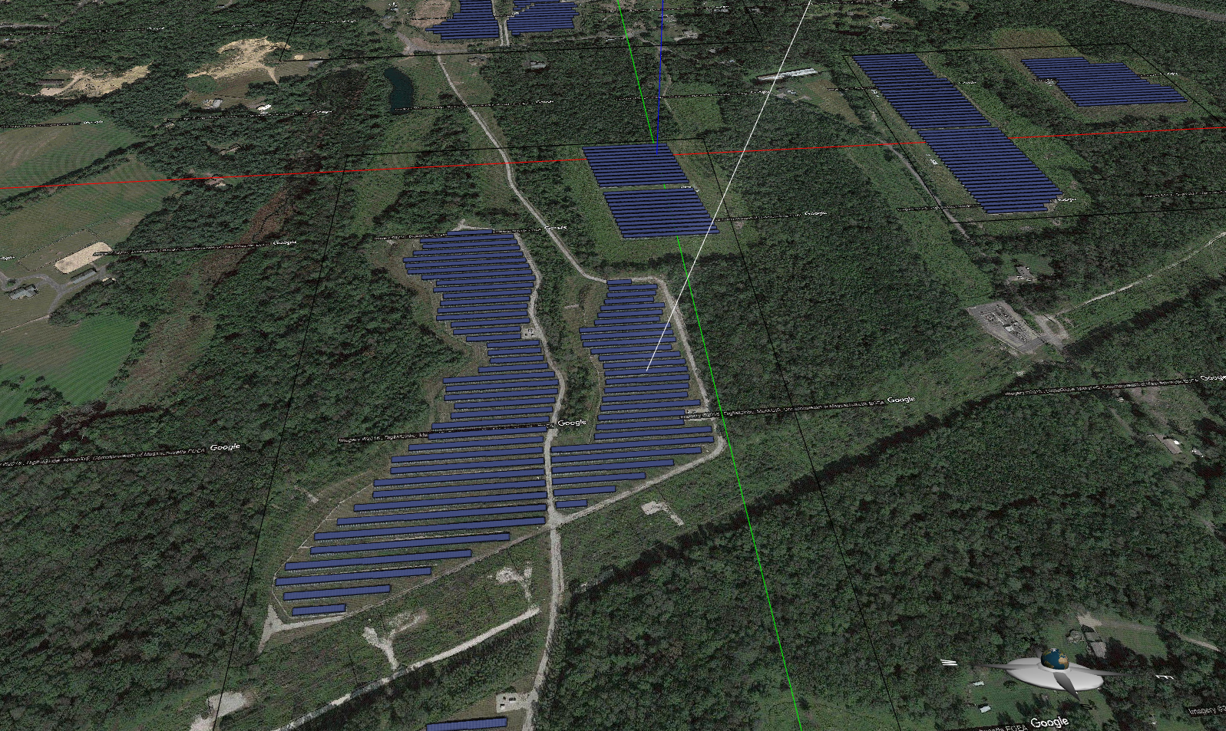
Examples: Ground-Mounted Solar Farms (Warren, MA)

Slide 17
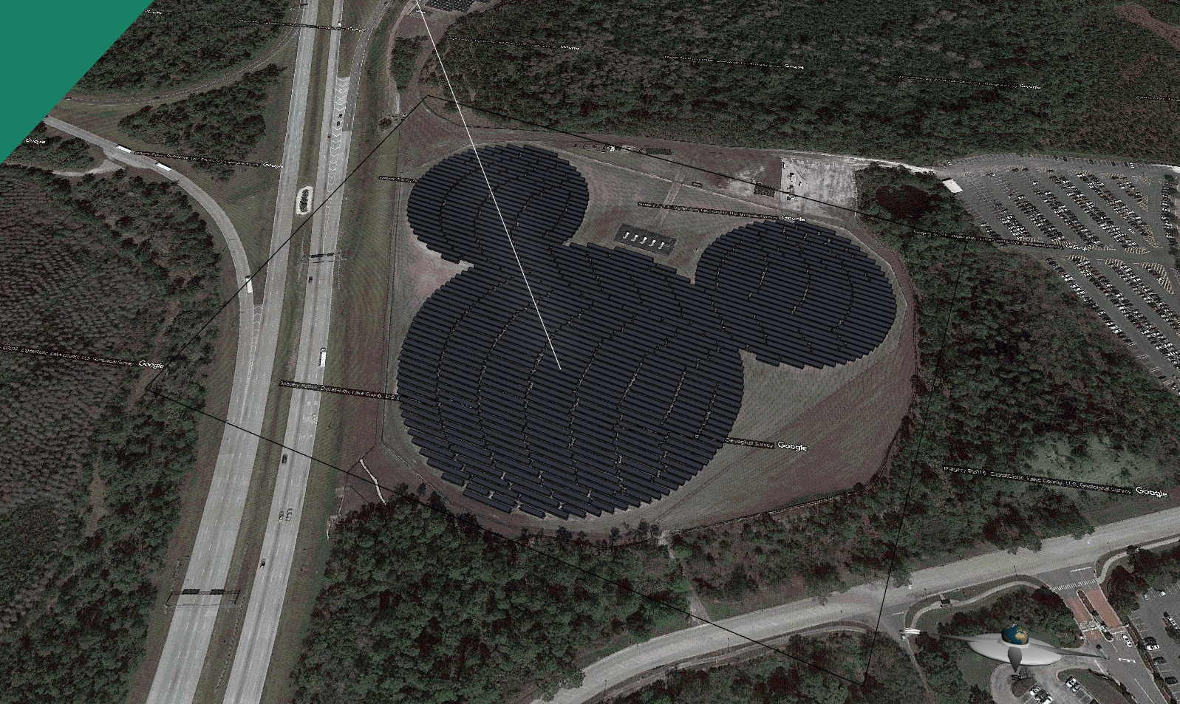
Examples: Advertisement-Integrated Photovoltaics (Orlando, FL)

Slide 18
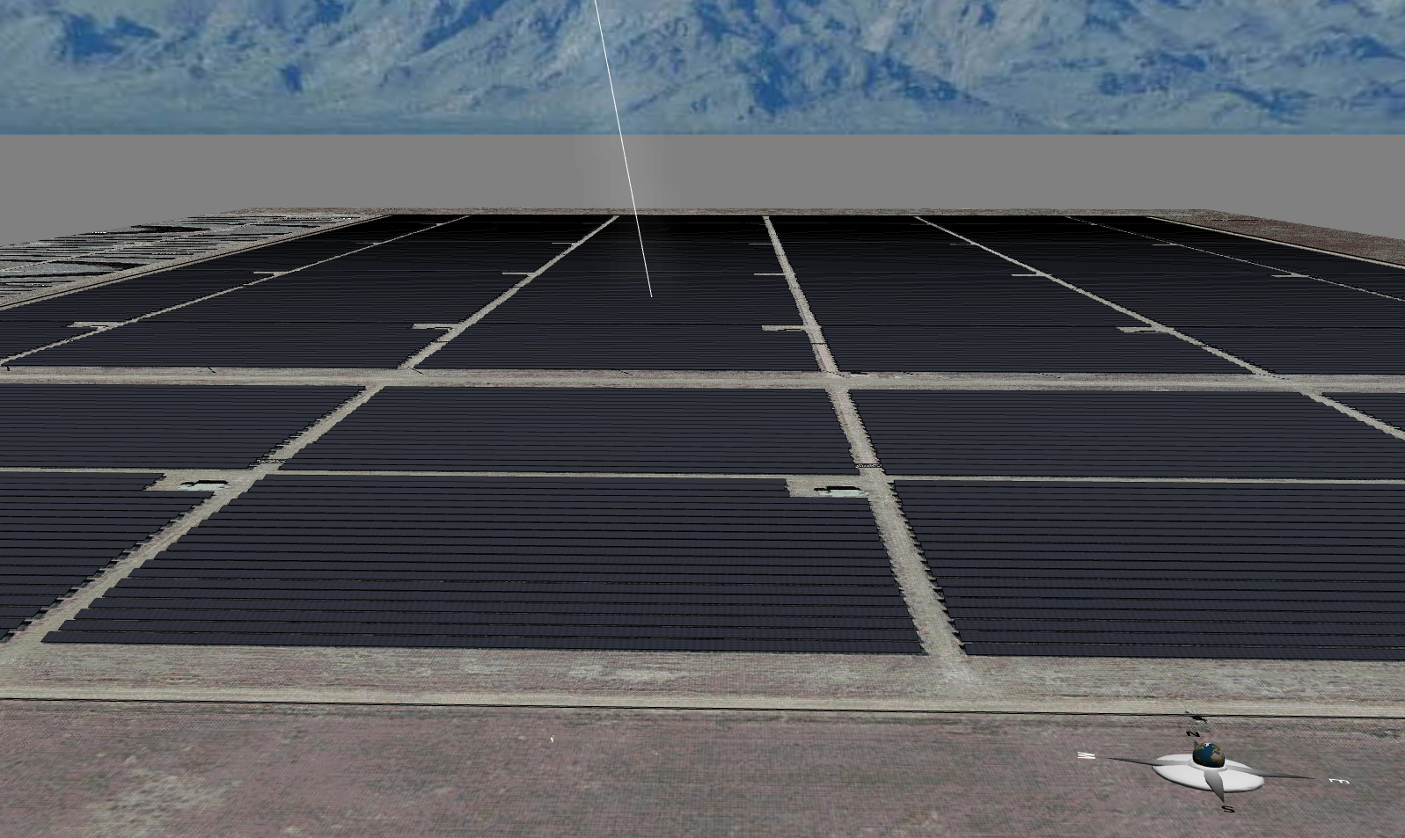
Examples: Topaz Solar Farm, California

Slide 19
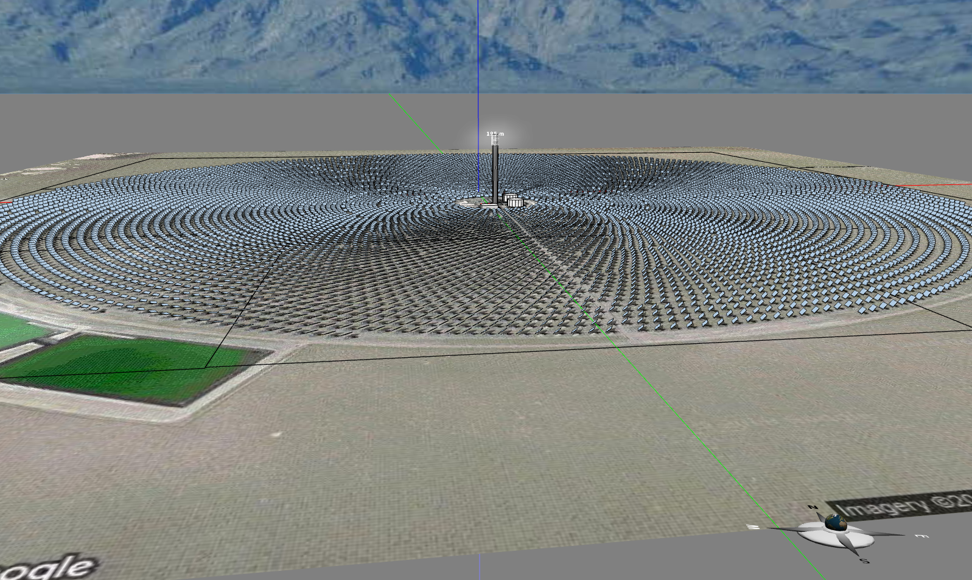
Examples: Crescent Dunes Solar Tower, Nevada

Slide 20
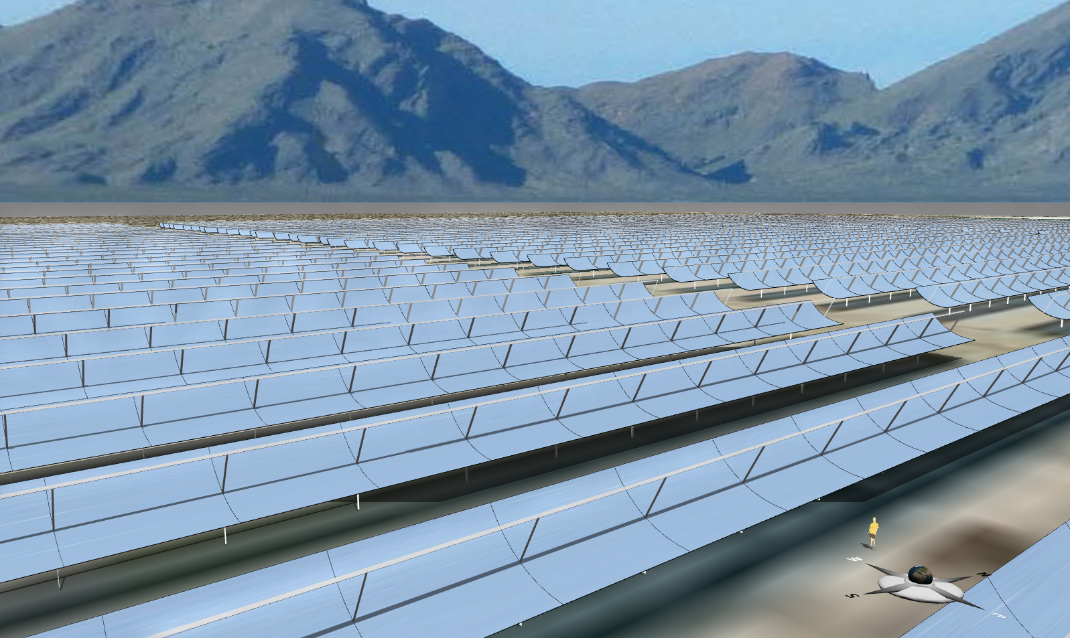
Examples: Solar Energy Generating Systems VIII, California

Slide 21
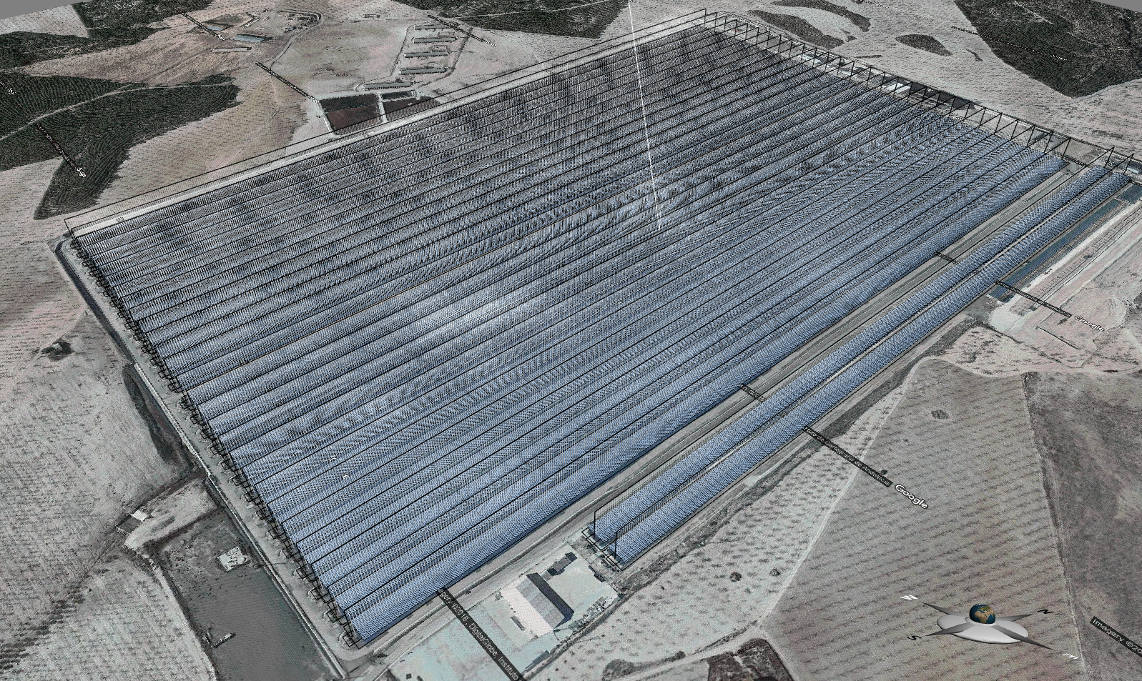
Examples: Puerto Errado Thermosolar Power Plant, Spain

Slide 22
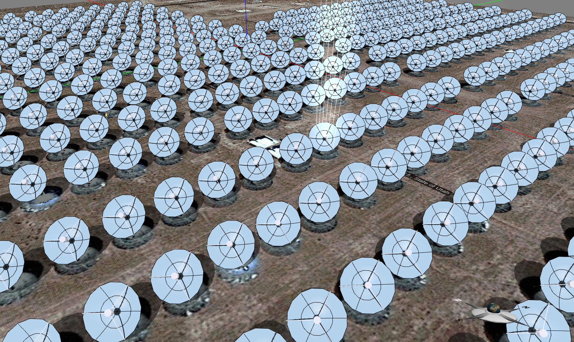
Examples: Tooele Army Depot, UT

Slide 23
Thank you!

